Slide 2
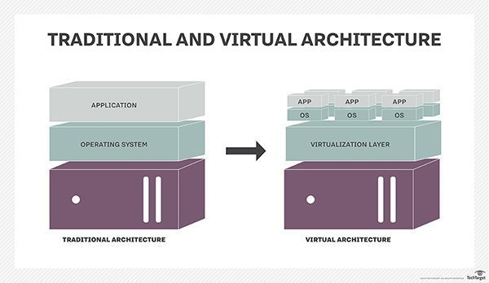

Slide 3
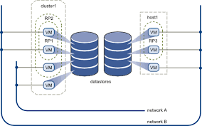

Slide 4
Virtualization Structures/Tools and Mechanisms
In general, there are three typical classes of VM architecture.
1. hypervisor architecture,
2. Para-virtualization
3. host-based virtualization

Slide 5
1. Hypervisor and Xen Architecture
The hypervisor supports hardware-level virtualization.
The hypervisor software sits directly between the physical hardware and its OS.
The hypervisor provides hyper calls for the guest OSes and applications.
Depending on the functionality, a hypervisor can assume a microkernel architecture like the Microsoft Hyper-V.
Or it can assume a monolithic hypervisor architecture like the VMware ESX for server virtualization.
A micro-kernel hypervisor includes only the basic and unchanging functions (such as physical memory management and processor scheduling).
The device drivers and other changeable components are outside the hypervisor.
A monolithic hypervisor implements all the aforementioned functions, including those of the device drivers.

Slide 6
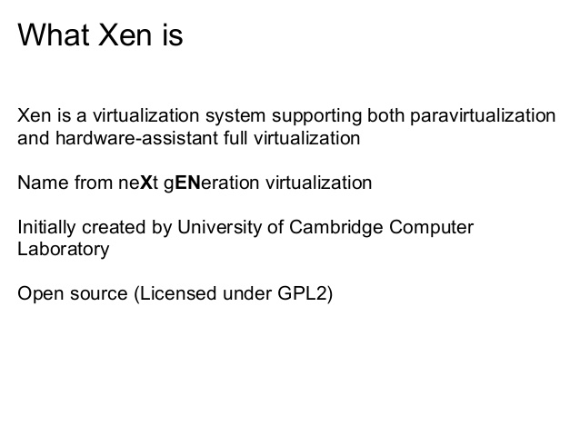
The Xen Architecture

Slide 7
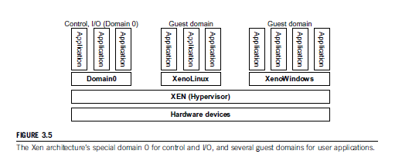
The Xen Architecture

Slide 8
Xen Architecture
Xen is a microkernel hypervisor, which separates the policy from the mechanism.
It implements all the mechanisms, leaving the policy to be handled by Domain 0, as shown in Figure.
Xen does not include any device drivers natively. It just provides a mechanism by which a guest OS can have direct access to the physical devices.

Slide 9
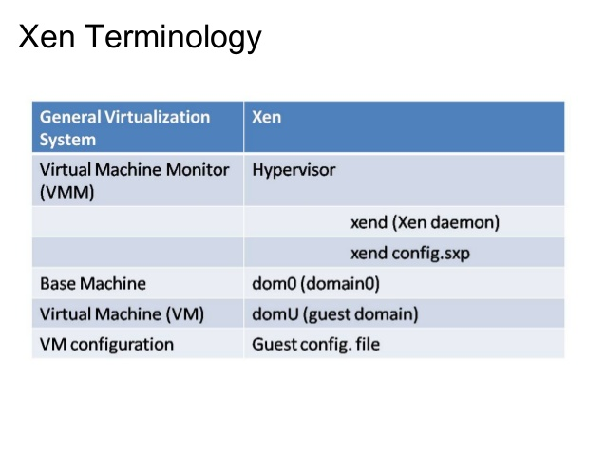

Slide 10
2.Para-virtualization
Paravirtualization enables several different operating systems to run on one set of hardware by effectively using resources such as processors and memory.
In paravirtualization, the operating system is modified to work with a virtual machine.
The intention behind the modification of the operating system is to minimize the execution time required in performing the operations that are otherwise difficult to run in a virtual environment.

Slide 11
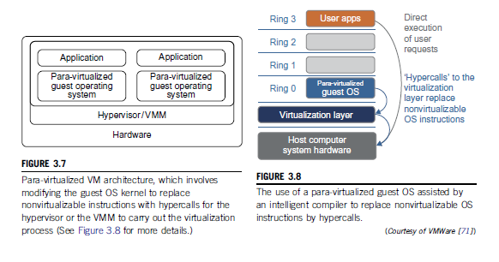
2.Para-virtualization

Slide 12
2.Para-virtualization
Figure 3.7 illustrates the concept of a para-virtualized VM architecture. The guest operating systems are para-virtualized. They are assisted by an intelligent compiler to replace the nonvirtualizable OS instructions by hypercalls as illustrated in Figure 3.8.
The traditional x86 processor offers four instruction execution rings: Rings 0, 1, 2, and 3. The lower the ring number, the higher the privilege of instruction being executed. The OS is responsible for managing the hardware and the privileged instructions to execute at Ring 0, while user-level applications run at Ring 3. The best example of para-virtualization is the KVM

Slide 13
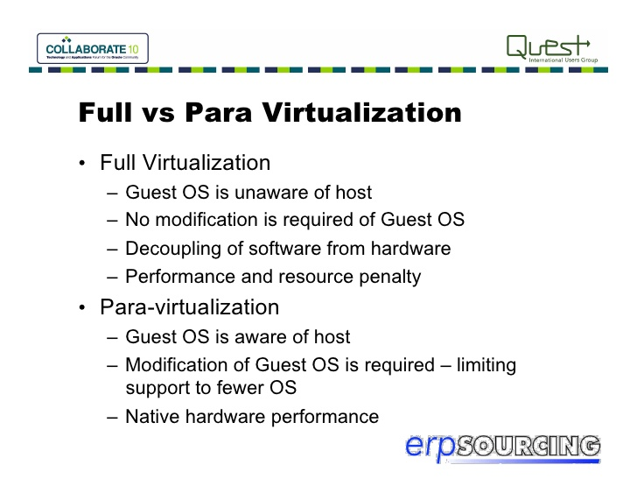
2.Para-virtualization

Slide 14
3. host-based virtualization
A host-based virtual machine is an instance of a desktop operating system that runs on a centralized server. Access and control is provided to the user by a client device connected over a network. Multiple host-based virtual machines can run on a single server.
With a host-based virtual machine, data is contained on the server, server resources can be allocated to users as needed, users can work from a variety of clients in different locations, and all of the virtual machines can be managed centrally. However, the client device must always be connected to the server in order to access the virtual machine, and when one single server is compromised many users can be affected.
Ex:
Host-based virtual machines are conceptually similar to Windows Terminal Server environments.
Host virtualization - On the existing host along with your favourite music player, text editor, hypervisor is installed just like an app

Slide 15
CPU Virtualization
CPU Virtualization is a hardware feature found in all current AMD & Intel CPUs that allows a single processor to act as if it was multiple individual CPUs.
CPU virtualization involves a single CPU acting as if it were multiple separate CPUs. The most common reason for doing this is to run multiple different operating systems on one machine. CPU virtualization emphasizes performance and runs directly on the available CPUs whenever possible.

Slide 16
VIRTUALIZATION OF CPU, MEMORY, AND I/O DEVICES
To support virtualization, processors such as the x86 employ a special running mode and instructions, known as hardware assisted virtualization.
Modern operating systems and processors permit multiple processes to run simultaneously.

Slide 19
Two Types of Hypervisor (1/2)
In their 1974 article "Formal Requirements for Virtualizable Third Generation Architectures" Gerald J. Popek and Robert P. Goldberg classified two types of hypervisor:
  Type 1 hypervisor : bare metal type
  Type 2 hypervisor : hosted type

Slide 20
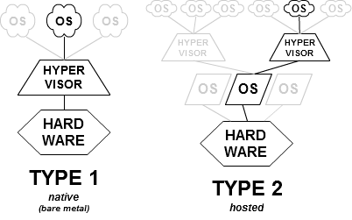
Two Types of Hypervisor (2/2)
Type 1 (or native, bare metal)
hypervisors
Type 2 (or hosted)
hypervisors
http://en.wikipedia.org/wiki/Hypervisor

Slide 21
Purposes of Hypervisor
CPU Virtualization
  Handle all sensitive instructions by emulation
Memory Virtualization
  Allocate guest physical memory
  Translate guest virtual address to host virtual address
I/O Virtualization
  Emulate I/O devices for guest
  Ex: Keyboard, UART, Storage and Network

Slide 22
